Slide 1
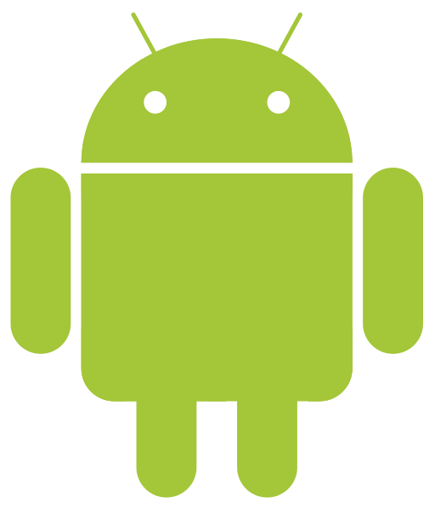
Introduction to Android
Nguyễn Hoàng Duy Thiện
thiennhd@tvu.edu.vn
0989 274 222

Slide 2



Android
Mobile OS based on the Linux kernel initially developed by Android, Inc. (Google bought in 2005)
Unveiled in 2007, along with the founding of the Open Handset Alliance
Designed primarily for touchscreen mobile devices: smart phones, tablets, televisions, cars, wrist watches, etc.
Source code is released by Google under open source licenses

Slide 3

Android
Google Play: over 2.7 million apps, 50 billion applications downloaded (02/2017)
1 billion active monthly users (5/2017)
40% of full-time professional developers see Android as the "priority" target platform, more than iOS (37%) or other platforms (2/2015)
Source: https://en.wikipedia.org/wiki/Android_(operating_system)

Slide 4
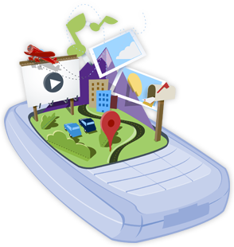
Open Handset Alliance
Consortium of 84 firms to develop open standards for mobile devices(05/11/2007)
Members include mobile handset makers, application developers, some mobile carriers and chip makers: Google, HTC, Sony, Dell, Intel, Motorola, Qualcomm, Texas Instruments, Samsung Electronics, LG Electronics, T-Mobile, Sprint Corporation, Nvidia, etc.
Open-source license, competed against mobile platforms from Apple, Microsoft, Nokia, and BlackBerry

Slide 5
Platform usage (17/6/2019)
9.0 Pie
8.0, 8.1 Oreo (15.8%)
7.0, 7.1 Nougat
6.0 Marshmallow (32.9%)
5.0, 5.1 Lollipop (28.8%)
4.4 KitKat (15.1%)
4.1, 4.2, 4.3 Jelly Bean (6.9%)
4.0 Ice Cream Sandwich (0.6%)
3.0, 3.1, 3.2 Honeycomb
2.3 Gingerbread (0.6%)
2.2 Froyo
2.0, 2.1 Eclair
1.6 Donut
1.5 Cupcake
1.1 Bender
1.0 Astro

Slide 6
Recent released versions
9.0 Pie (8/2018)
8.0, 8.1 Oreo (8/2017–12/2017)
7.0, 7.1 Nougat (8/2016–10/2016)
6.0 Marshmallow (10/2015)
5.0, 5.1 Lollipop (11/2014–3/2015)
4.4 KitKat (10/2013)
4.1, 4.2, 4.3 Jelly Bean (7/2012–7/2013)
4.0 Ice Cream Sandwich (12/2011)
2.3 - 2.3.7 Gingerbread (02/2011)

Slide 7

Jelly Bean
4.1, 4.2, 4.3 Jelly Bean (7/2012–7/2013)
  Faster, Smoother, More Responsive
  Enhanced Accessibility
  Support for International Users
  New Way to Create Beautiful UI
  New Input Types and Capabilities
  Animation and Graphics
  New Types of Connectivity
  New Media Capabilities
  Renderscript Computation
  Android Browser and Webview
  Google APIs and services
  Source: https://www.android.com/versions/jelly-bean-4-3/

Slide 8

KitKat
4.4 KitKat (10/2013)
  This is your task: finding out the information on the website
  https://www.android.com/versions/kit-kat-4-4/

Slide 9

Lollipop
5.0, 5.1 Lollipop (11/2014 – 3/2015)
  This is also your task: finding out the information on the website
  https://www.android.com/versions/lollipop-5-0/

Slide 10
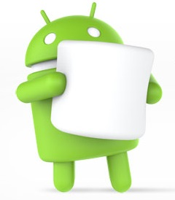
Marshmallow
6.0 Marshmallow (10/2015)
  This is also your task: finding out the information on the website
  https://www.android.com/versions/marshmallow-6-0/

Slide 11

Nougat
7.0, 7.1 Nougat (8/2016–10/2016)
  This is also your task: finding out the information on the website
  https://www.android.com/versions/nougat-7-0/

Slide 12
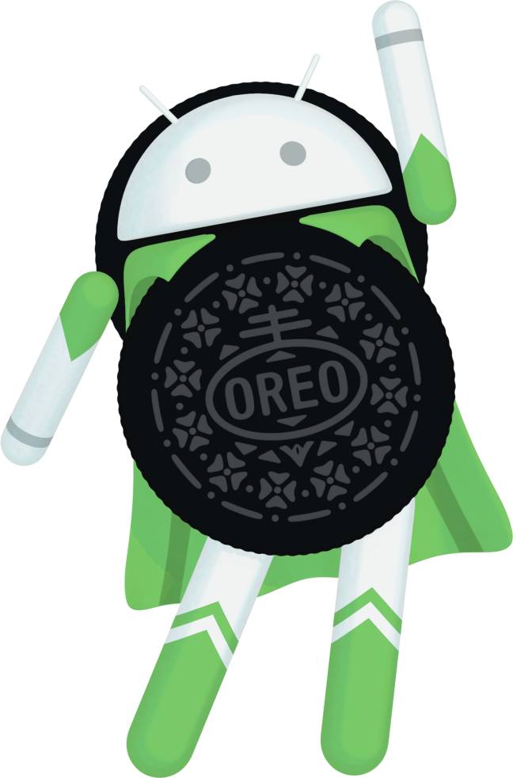
Oreo
8.0, 8.1 Oreo (8/2017 – 12/2017)
  This is also your task: finding out the information on the website
  https://www.android.com/versions/oreo-8-0/

Slide 13
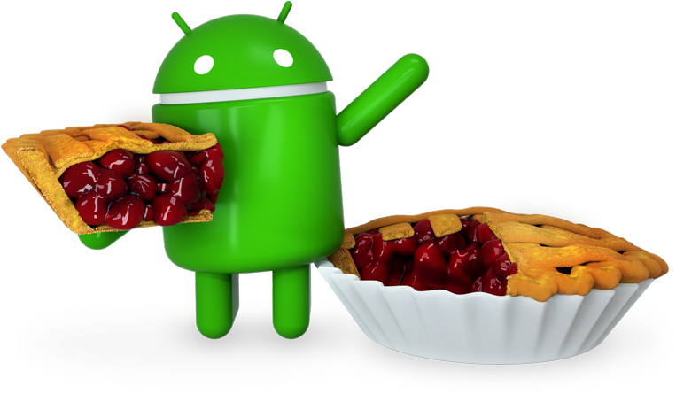
Pie
9.0 Pie (06/8/2018)
  This is also your task: finding out the information on the website
  https://www.android.com/versions/pie-9-0/

Slide 14
Features
Security: open source, easy to fix bugs
Quality: friendly to users
Customisation: add / remove features
Cost: FREE

Slide 15
Advantages
Developers
  Open source code OS
  Free SDK
End-users
  Vast store
  Multi-task OS

Slide 16
Disadvantages
Security: open source, easy to be hacked
Idea: copy from iOS

Slide 17
Specifications (1)
Handset layouts
Storage
Connectivity
Messaging
Multiple language support
Web browser
Java support
Media support
Streaming media support

Slide 18
Specifications (2)
Additional hardware support
Multi-touch
Bluetooth
Video calling
Multitasking
Voice based features
Tethering
Screen capture
External storage

Slide 19
Developing Applications
Google Android Software Development Kit (SDK): Android Studio
PhoneGap
IBM MobileFirst Platform (IBM Worklight)
iBuildApp
MIT App Inventor

Slide 20
Google Play Store (Android Market)
Digital distribution platform operated by Google serves as the official app, digital media (music, magazines, books, movies, and television programs)
Sell
https://play.google.com/apps/publish/signup
Purchase
https://wallet.google.com/manage

